Slide 1
APPLIED COST-EFFECTIVENESS MODELING WITH R

Slide 2
Learning objectives
Understand how R can be used to perform model-based cost-effectiveness analysis with existing packages;
Develop own models in R by modifying existing code for commonly used model types;
Understand how using R can improve reproducibility and transparency of model-based cost-effectiveness analysis

Slide 3
Agenda
Introduction
Basic model taxonomy
Simple Markov cohort models
Partitioned survival models
Time-varying state-transition models
Decision analysis
Summary

Slide 4
Structure
Presentation
Exercises using R (R-cloud)

Slide 5
Introduction

Slide 6
Criteria that economic models should strive to meet
Clinical realism
A model should reflect the state of evidence, the current understanding of the disease, and be accepted by clinical experts.
Quantifying decision uncertainty
A model should be capable of quantifying decision uncertainty and informing prioritization of future research.
Transparency and reproducibility
Resources should exist so that a model can be completely understood, reproduced, and pressure tested.
Reusability and adaptability
It should be possible to easily update a model to reflect new clinical evidence or adapt it for a new market, indication, or intervention.
Notes:
Historically, models have been developed with specialized commercial software (such as TreeAge) or more commonly with spreadsheet software (almost always Microsoft Excel). Although these tools may be sufficient for relatively simple analyses, methodological and computational advances now allow for models that are increasingly sophisticated and realistic but cannot be reasonably computed in Excel. Related fields such as statistics, economics, and machine learning utilize many of these advances and consequently make heavy use of modern programming languages such as R, Python, MATLAB, and Julia.¹⁻⁴ Yet, in the context of HTA, there seems to be an ongoing preference among manufactures preparing submissions and reviewers for economic models in Excel.

Slide 7
Structural uncertainty
Notes:
How can we capture multiple model structures with excel

Slide 8

Plugging in model input parameter estimates

Slide 9
Transparency & reproducibility

Slide 10
What do we mean with model transparency?
Concept, math
Face validity
Implementation/programming
Open-source, open-access
Familiarity with software?

Slide 11
Modeling in Excel
Excel has been dominant software platform used by modelers forever, especially for HTA submissions
Reasons are not surprising
(practically) Everyone with a computer has access to Excel
Does not require that you learn a new programming language
Many users consider its “transparency” to be an attribute
With models in Excel, you can follow calculations that are being performed in every single cell of every single worksheet

Slide 12
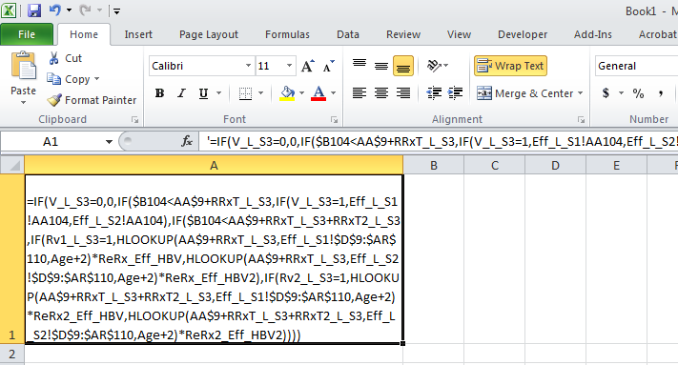
Modeling in Excel
Virtually all textbooks use it
And for simple models, it is transparent and fast to build
However……
Transparent???

Slide 13
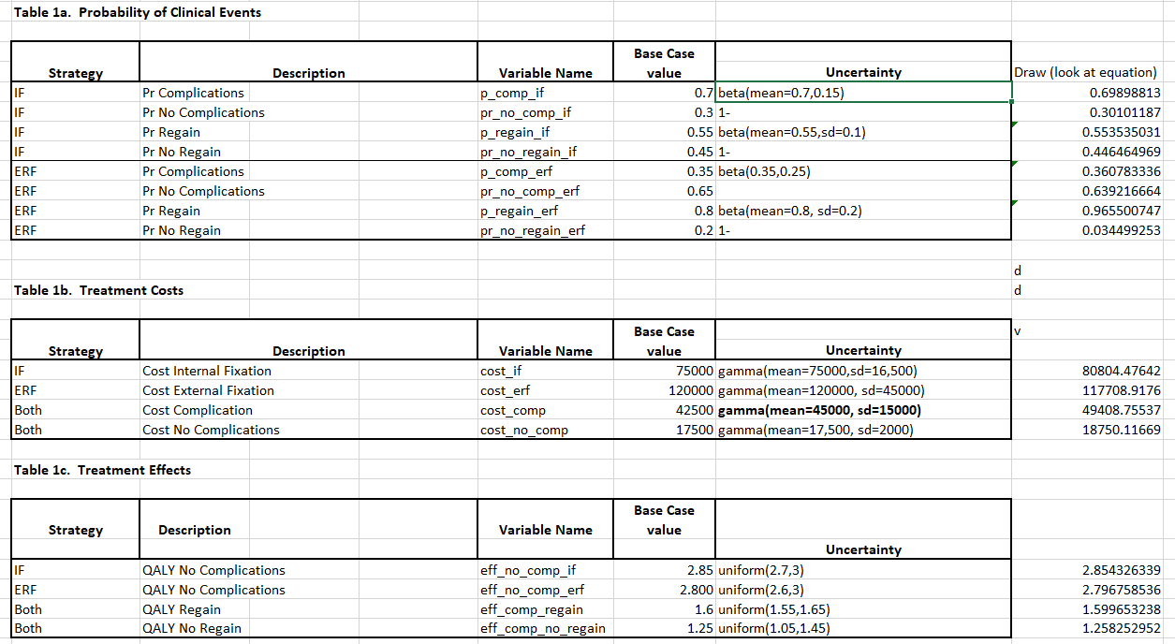

Slide 14
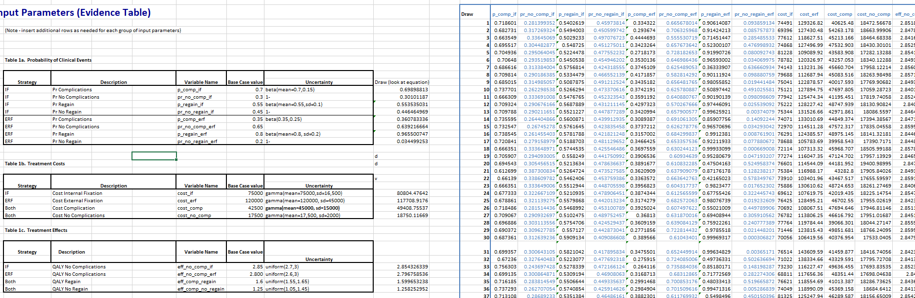

Slide 15
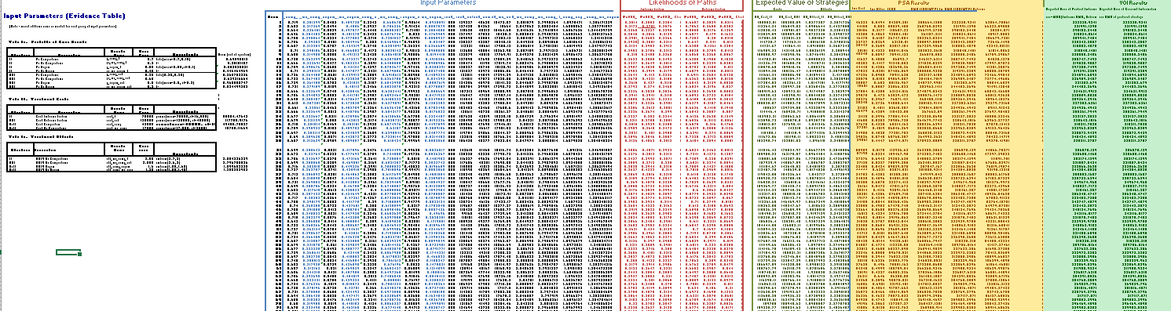

Slide 16
Where is Waldo

Slide 17
Criticisms
Really hard to check, models can be validated by building second one from scratch, this is rarely done due to budget and time constraints
Complex procedures generally require VBA knowledge
Increasingly more data and other models, inform CEA. Excel cannot do all of these things
Slow performance with large and complex models

Slide 18

Time to change?

Slide 19
Alternative
BCEA HEEMOD HESIM …

Slide 20



What is R
Statistical programing language and environment for statistical computing
Totally free to use (open source, user developed packages that are completely transparent)
Very good for regression analysis, hypothesis testing, data management, visualization and cleaning (and many, many other things)
All parts of an analysis can exist in one file (code)
CEA models can be coded from ‘scratch’ using r core or via convenient and improving packages

Slide 21
Programing in R
Everything is an object or function
Code can be highly customized or generalized to suit purposes
Packages are shareable bundles of code, data and documentation that allow for reproducible analysis
Built for statistical analysis, contains may functions relevant for CEA
There are many ways to do the same thing

Slide 22
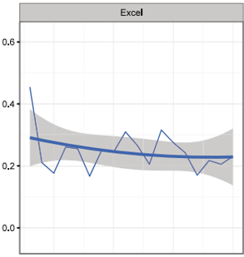
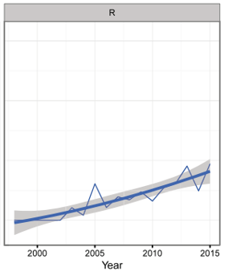
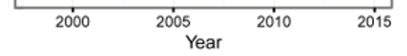

An Overview of R in Health Decision Sciences Jalal et al. (Med Decis Making 2017;37: 735–746)

Slide 23
Basic model taxonomy

Slide 26
Simple Markov cohort models

Slide 27
HIV model (Chancellor et al. 1997)

Slide 28
HIV model (Chancellor et al. 1997)
Annual transition probabilities with monotherapy
Relative risk of disease progression with combination therapy 0.509
Drug costs
Other annual costs
Annual discount rates of 6% for costs and 0% for life years
 | State A | State B | State C | State D
State A | 0.721 | 0.202 | 0.067 | 0.010
State B | 0.000 | 0.581 | 0.407 | 0.012
State C | 0.000 | 0.000 | 0.750 | 0.250
State D | 0.000 | 0.000 | 0.000 | 1.000
 | cAZT | cLam
Drug costs | 2278 | 2087
 | State A | State B | State C
Direct medical | 1701 | 1774 | 6948
Community | 1055 | 1278 | 2059
Total | 2756 | 3052 | 9007

Slide 29
Model output with Excel
 | MONOTHERAPY |  |  |  | Life | Years | Costs |  |  | COMBINATION THERAPY |  |  |  | Life | Years | Costs
Year | A | B | C | D | no disc | disc | no disc | disc |  | A | B | C | D | no disc | disc | no disc | disc
0 | 1 |  |  |  |  |  |  |  |  | 1
1 | 0.721 | 0.202 | 0.067 | 0.010 | 0.99 | 0.99 | £ 5,463 | £ 5,153 |  | 0.858 | 0.103 | 0.034 | 0.005 | 1.00 | 1.00 | £ 7,328 | £ 6,913
2 | 0.520 | 0.263 | 0.181 | 0.036 | 0.96 | 0.96 | £ 6,060 | £ 5,393 |  | 0.737 | 0.169 | 0.080 | 0.014 | 0.99 | 0.99 | £ 7,571 | £ 6,738
3 | 0.376 | 0.258 | 0.277 | 0.089 | 0.91 | 0.91 | £ 6,394 | £ 5,368 |  | 0.531 | 0.247 | 0.178 | 0.044 | 0.96 | 0.96 | £ 6,002 | £ 5,040
4 | 0.271 | 0.226 | 0.338 | 0.165 | 0.83 | 0.83 | £ 6,381 | £ 5,055 |  | 0.383 | 0.251 | 0.270 | 0.096 | 0.90 | 0.90 | £ 6,310 | £ 4,998
5 | 0.195 | 0.186 | 0.364 | 0.255 | 0.74 | 0.74 | £ 6,077 | £ 4,541 |  | 0.277 | 0.223 | 0.330 | 0.170 | 0.83 | 0.83 | £ 6,305 | £ 4,712
6 | 0.141 | 0.147 | 0.361 | 0.350 | 0.65 | 0.65 | £ 5,574 | £ 3,929 |  | 0.200 | 0.185 | 0.357 | 0.258 | 0.74 | 0.74 | £ 6,020 | £ 4,244
7 | 0.102 | 0.114 | 0.341 | 0.444 | 0.56 | 0.56 | £ 4,963 | £ 3,301 |  | 0.144 | 0.148 | 0.357 | 0.351 | 0.65 | 0.65 | £ 5,537 | £ 3,682
8 | 0.073 | 0.087 | 0.309 | 0.531 | 0.47 | 0.47 | £ 4,316 | £ 2,708 |  | 0.104 | 0.115 | 0.337 | 0.444 | 0.56 | 0.56 | £ 4,943 | £ 3,101
9 | 0.053 | 0.065 | 0.272 | 0.610 | 0.39 | 0.39 | £ 3,682 | £ 2,179 |  | 0.075 | 0.088 | 0.307 | 0.530 | 0.47 | 0.47 | £ 4,308 | £ 2,550
10 | 0.038 | 0.049 | 0.234 | 0.679 | 0.32 | 0.32 | £ 3,092 | £ 1,727 |  | 0.054 | 0.066 | 0.271 | 0.609 | 0.39 | 0.39 | £ 3,682 | £ 2,056
11 | 0.028 | 0.036 | 0.198 | 0.739 | 0.26 | 0.26 | £ 2,564 | £ 1,350 |  | 0.039 | 0.049 | 0.234 | 0.678 | 0.32 | 0.32 | £ 3,098 | £ 1,632
12 | 0.020 | 0.026 | 0.165 | 0.789 | 0.21 | 0.21 | £ 2,102 | £ 1,045 |  | 0.028 | 0.037 | 0.198 | 0.737 | 0.26 | 0.26 | £ 2,572 | £ 1,278
13 | 0.014 | 0.019 | 0.136 | 0.830 | 0.17 | 0.17 | £ 1,708 | £ 801 |  | 0.020 | 0.027 | 0.165 | 0.787 | 0.21 | 0.21 | £ 2,111 | £ 990
14 | 0.010 | 0.014 | 0.111 | 0.865 | 0.14 | 0.14 | £ 1,377 | £ 609 |  | 0.015 | 0.020 | 0.136 | 0.829 | 0.17 | 0.17 | £ 1,717 | £ 760
15 | 0.007 | 0.010 | 0.090 | 0.893 | 0.11 | 0.11 | £ 1,103 | £ 460 |  | 0.011 | 0.014 | 0.111 | 0.864 | 0.14 | 0.14 | £ 1,386 | £ 578
16 | 0.005 | 0.008 | 0.072 | 0.915 | 0.08 | 0.08 | £ 878 | £ 346 |  | 0.008 | 0.011 | 0.090 | 0.892 | 0.11 | 0.11 | £ 1,111 | £ 437
17 | 0.004 | 0.005 | 0.057 | 0.933 | 0.07 | 0.07 | £ 695 | £ 258 |  | 0.005 | 0.008 | 0.072 | 0.915 | 0.09 | 0.09 | £ 885 | £ 329
18 | 0.003 | 0.004 | 0.045 | 0.948 | 0.05 | 0.05 | £ 548 | £ 192 |  | 0.004 | 0.006 | 0.058 | 0.933 | 0.07 | 0.07 | £ 701 | £ 246
19 | 0.002 | 0.003 | 0.036 | 0.959 | 0.04 | 0.04 | £ 431 | £ 142 |  | 0.003 | 0.004 | 0.046 | 0.947 | 0.05 | 0.05 | £ 553 | £ 183
20 | 0.0015 | 0.0021 | 0.0282 | 0.9682 | 0.03 | 0.03 | £ 337 | £ 105 |  | 0.002 | 0.003 | 0.036 | 0.959 | 0.04 | 0.04 | £ 435 | £ 136
 |  |  |  |  | 7.99 | 7.99 | £63,745 | £44,663 |  |  |  |  |  | 8.94 | 8.94 | £72,575 | £50,602

Slide 30
Model calculations with Excel
 | MONOTHERAPY |  |  |  | Life | Years | Costs
Year | A | B | C | D | no disc | disc | no disc | disc
0 | 1
1 | =B7*(1-tpA2B-tpA2C-tpA2D) | =B7*tpA2B+C7*tpB2B | =B7*tpA2C+C7*tpB2C+D7*tpC2C | =B7*tpA2D+C7*tpB2D+D7*tpC2D+E7 | =SUM(B8:D8) | =F8/(1+oDR)^A8 | =(B8*(dmca+ccca+cAZT)+C8*(dmcb+cccb+cAZT)+D8*(dmcc+cccc+cAZT)) | =H8/(1+cDR)^A8
2 | =B8*(1-tpA2B-tpA2C-tpA2D) | =B8*tpA2B+C8*tpB2B | =B8*tpA2C+C8*tpB2C+D8*tpC2C | =B8*tpA2D+C8*tpB2D+D8*tpC2D+E8 | =SUM(B9:D9) | =F9/(1+oDR)^A9 | =(B9*(dmca+ccca+cAZT)+C9*(dmcb+cccb+cAZT)+D9*(dmcc+cccc+cAZT)) | =H9/(1+cDR)^A9
3 | =B9*(1-tpA2B-tpA2C-tpA2D) | =B9*tpA2B+C9*tpB2B | =B9*tpA2C+C9*tpB2C+D9*tpC2C | =B9*tpA2D+C9*tpB2D+D9*tpC2D+E9 | =SUM(B10:D10) | =F10/(1+oDR)^A10 | =(B10*(dmca+ccca+cAZT)+C10*(dmcb+cccb+cAZT)+D10*(dmcc+cccc+cAZT)) | =H10/(1+cDR)^A10
4 | =B10*(1-tpA2B-tpA2C-tpA2D) | =B10*tpA2B+C10*tpB2B | =B10*tpA2C+C10*tpB2C+D10*tpC2C | =B10*tpA2D+C10*tpB2D+D10*tpC2D+E10 | =SUM(B11:D11) | =F11/(1+oDR)^A11 | =(B11*(dmca+ccca+cAZT)+C11*(dmcb+cccb+cAZT)+D11*(dmcc+cccc+cAZT)) | =H11/(1+cDR)^A11
5 | =B11*(1-tpA2B-tpA2C-tpA2D) | =B11*tpA2B+C11*tpB2B | =B11*tpA2C+C11*tpB2C+D11*tpC2C | =B11*tpA2D+C11*tpB2D+D11*tpC2D+E11 | =SUM(B12:D12) | =F12/(1+oDR)^A12 | =(B12*(dmca+ccca+cAZT)+C12*(dmcb+cccb+cAZT)+D12*(dmcc+cccc+cAZT)) | =H12/(1+cDR)^A12
6 | =B12*(1-tpA2B-tpA2C-tpA2D) | =B12*tpA2B+C12*tpB2B | =B12*tpA2C+C12*tpB2C+D12*tpC2C | =B12*tpA2D+C12*tpB2D+D12*tpC2D+E12 | =SUM(B13:D13) | =F13/(1+oDR)^A13 | =(B13*(dmca+ccca+cAZT)+C13*(dmcb+cccb+cAZT)+D13*(dmcc+cccc+cAZT)) | =H13/(1+cDR)^A13
16 | =B22*(1-tpA2B-tpA2C-tpA2D) | =B22*tpA2B+C22*tpB2B | =B22*tpA2C+C22*tpB2C+D22*tpC2C | =B22*tpA2D+C22*tpB2D+D22*tpC2D+E22 | =SUM(B23:D23) | =F23/(1+oDR)^A23 | =(B23*(dmca+ccca+cAZT)+C23*(dmcb+cccb+cAZT)+D23*(dmcc+cccc+cAZT)) | =H23/(1+cDR)^A23
17 | =B23*(1-tpA2B-tpA2C-tpA2D) | =B23*tpA2B+C23*tpB2B | =B23*tpA2C+C23*tpB2C+D23*tpC2C | =B23*tpA2D+C23*tpB2D+D23*tpC2D+E23 | =SUM(B24:D24) | =F24/(1+oDR)^A24 | =(B24*(dmca+ccca+cAZT)+C24*(dmcb+cccb+cAZT)+D24*(dmcc+cccc+cAZT)) | =H24/(1+cDR)^A24
18 | =B24*(1-tpA2B-tpA2C-tpA2D) | =B24*tpA2B+C24*tpB2B | =B24*tpA2C+C24*tpB2C+D24*tpC2C | =B24*tpA2D+C24*tpB2D+D24*tpC2D+E24 | =SUM(B25:D25) | =F25/(1+oDR)^A25 | =(B25*(dmca+ccca+cAZT)+C25*(dmcb+cccb+cAZT)+D25*(dmcc+cccc+cAZT)) | =H25/(1+cDR)^A25
19 | =B25*(1-tpA2B-tpA2C-tpA2D) | =B25*tpA2B+C25*tpB2B | =B25*tpA2C+C25*tpB2C+D25*tpC2C | =B25*tpA2D+C25*tpB2D+D25*tpC2D+E25 | =SUM(B26:D26) | =F26/(1+oDR)^A26 | =(B26*(dmca+ccca+cAZT)+C26*(dmcb+cccb+cAZT)+D26*(dmcc+cccc+cAZT)) | =H26/(1+cDR)^A26
20 | =B26*(1-tpA2B-tpA2C-tpA2D) | =B26*tpA2B+C26*tpB2B | =B26*tpA2C+C26*tpB2C+D26*tpC2C | =B26*tpA2D+C26*tpB2D+D26*tpC2D+E26 | =SUM(B27:D27) | =F27/(1+oDR)^A27 | =(B27*(dmca+ccca+cAZT)+C27*(dmcb+cccb+cAZT)+D27*(dmcc+cccc+cAZT)) | =H27/(1+cDR)^A27
 |  |  |  |  | =SUM(F8:F27) | =SUM(G8:G27) | =SUM(H8:H27) | =SUM(I8:I27)

Slide 31
Define transition matrix with monotherapy
transitions_mono <- matrix(c(0.721, 0.202, 0.067, 0.010,
0, 0.581, 0.407, 0.012,
0, 0, 0.750, 0.250,
0, 0, 0, 1 ),
ncol = 4, nrow = 4, byrow = TRUE)
> transitions_mono
[,1] [,2] [,3] [,4]
[1,] 0.721 0.202 0.067 0.010
[2,] 0.000 0.581 0.407 0.012
[3,] 0.000 0.000 0.750 0.250
[4,] 0.000 0.000 0.000 1.000

Slide 32
Relative risk and transition matrix with combination therapy
RR<-0.509
transitions_combi <- matrix(c((1-0.202*RR-0.067*RR-0.010*RR), 0.202*RR, 0.067*RR, 0.010*RR,
0, (1-0.407*RR-0.012*RR), 0.407*RR, 0.012*RR,
0, 0, (1-0.250*RR), 0.250*RR,
0, 0, 0, 1),
ncol = 4, nrow = 4, byrow = TRUE)
> transitions_combi
[,1] [,2] [,3] [,4]
[1,] 0.857989 0.102818 0.034103 0.005090
[2,] 0.000000 0.786729 0.207163 0.006108
[3,] 0.000000 0.000000 0.872750 0.127250
[4,] 0.000000 0.000000 0.000000 1.000000

Slide 33
Other model parameters
LY <- matrix(c(1, 1, 1, 0),nrow=1)
drug_cost_mono <- matrix(c(2278, 2278, 2278, 0),nrow=1)
drug_cost_combi <- matrix(c(2278+2087, 2278+2087, 2278+2087, 0),nrow=1)
other_cost <- matrix(c(2756, 3052, 9007, 0),nrow=1)
discount_LY <- 0.00
discount_cost <- 0.06
> LY
[,1] [,2] [,3] [,4]
[1,] 1 1 1 0
> discount_LY
[1] 0
> discount_cost
[1] 0.06
> drug_cost_mono
[,1] [,2] [,3] [,4]
[1,] 2278 2278 2278 0
> drug_cost_combi
[,1] [,2] [,3] [,4]
[1,] 4365 4365 4365 0
> other_cost
[,1] [,2] [,3] [,4]
[1,] 2756 3052 9007 0

Slide 34
Basic calculations – health state occupancy with monotherapy
initial<-matrix(c(1,0,0,0),nrow=1)
[,1] [,2] [,3] [,4]
[1,] 1 0 0 0
initial %*% transitions_mono
[,1] [,2] [,3] [,4]
[1,] 0.721 0.202 0.067 0.01
initial %*% transitions_mono %*% transitions_mono %*% transitions_mono %*% transitions_mono %*% transitions_mono
[,1] [,2] [,3] [,4]
[1,] 0.1948392 0.185603 0.3634815 0.2560763
initial %*% (transitions_mono %^% 5)
[,1] [,2] [,3] [,4]
[1,] 0.1948392 0.185603 0.3634815 0.2560763

Slide 35
Basic calculations – expected LY and costs with monotherapy
expected_LY_mono <- sum(
initial %*% (transitions_mono %^% 1) * LY * 1/(1+discount_LY)^1,
initial %*% (transitions_mono %^% 2) * LY * 1/(1+discount_LY)^2,
initial %*% (transitions_mono %^% 3) * LY * 1/(1+discount_LY)^3,
initial %*% (transitions_mono %^% 4) * LY * 1/(1+discount_LY)^4,
initial %*% (transitions_mono %^% 5) * LY * 1/(1+discount_LY)^5
)
> expected_LY_mono
[1] 4.441473
expected_total_cost_mono <- sum(
initial %*% (transitions_mono %^% 1) * (drug_cost_mono + other_cost) * 1/(1+discount_cost)^1,
initial %*% (transitions_mono %^% 2) * (drug_cost_mono + other_cost) * 1/(1+discount_cost)^2,
initial %*% (transitions_mono %^% 3) * (drug_cost_mono + other_cost) * 1/(1+discount_cost)^3,
initial %*% (transitions_mono %^% 4) * (drug_cost_mono + other_cost) * 1/(1+discount_cost)^4,
initial %*% (transitions_mono %^% 5) * (drug_cost_mono + other_cost) * 1/(1+discount_cost)^5
)
> expected_total_cost_mono
[1] 25501.45

Slide 36
Model output – trace monotherapy
follow_up <- 20
trace_mono<-matrix(rep(NA, 6 * follow_up), nrow=follow_up)
colnames(trace_mono) <- c("State A", "State B", "State C", "Death", "Disc LY", "Disc cost")
trace_mono

Slide 37
Model output – trace monotherapy
> trace_mono
State A State B State C Death Disc LY Disc cost
[1,] NA NA NA NA NA NA
[2,] NA NA NA NA NA NA
[3,] NA NA NA NA NA NA
[4,] NA NA NA NA NA NA
[5,] NA NA NA NA NA NA
[6,] NA NA NA NA NA NA
[7,] NA NA NA NA NA NA
[8,] NA NA NA NA NA NA
[9,] NA NA NA NA NA NA
[10,] NA NA NA NA NA NA
[11,] NA NA NA NA NA NA
[12,] NA NA NA NA NA NA
[13,] NA NA NA NA NA NA
[14,] NA NA NA NA NA NA
[15,] NA NA NA NA NA NA
[16,] NA NA NA NA NA NA
[17,] NA NA NA NA NA NA
[18,] NA NA NA NA NA NA
[19,] NA NA NA NA NA NA
[20,] NA NA NA NA NA NA

Slide 38
Model output – trace monotherapy
for(t in 1:follow_up){
trace_mono[t,1:4] <- initial %*% (transitions_mono %^%t)
trace_mono[t,5] <- sum( trace_mono[t,1:4] * LY * 1/(1+discount_LY)^t )
trace_mono[t,6] <- sum( trace_mono[t,1:4] * (drug_cost_mono + other_cost) * 1/(1+discount_cost)^t )
}
trace_mono

Slide 39
Model output – trace monotherapy
> trace_mono
State A State B State C Death Disc LY Disc cost
[1,] 0.721000000 0.202000000 0.06700000 0.01000000 0.99000000 5153.0840
[2,] 0.519841000 0.263004000 0.18077100 0.03638400 0.96361600 5392.2140
[3,] 0.374805361 0.257813206 0.27745022 0.08993121 0.91006879 5366.7964
[4,] 0.270234665 0.225500156 0.33812960 0.16613558 0.83386442 5052.0286
[5,] 0.194839194 0.185602993 0.36348149 0.25607633 0.74392367 4537.3315
[6,] 0.140479059 0.147192856 0.36120576 0.35112233 0.64887767 3925.1614
[7,] 0.101285401 0.113895819 0.34022391 0.44459487 0.55540513 3296.2640
[8,] 0.073026774 0.086633122 0.30830965 0.53203045 0.46796955 2703.2976
[9,] 0.052652304 0.065085252 0.27138471 0.61087773 0.38912227 2174.9502
[10,] 0.037962311 0.048450297 0.23355594 0.68003145 0.31996855 1722.6597
[11,] 0.027370827 0.035818009 0.19742970 0.73938147 0.26061853 1346.8318
[12,] 0.019734366 0.026339170 0.16448405 0.78944241 0.21055759 1041.6145
[13,] 0.014228478 0.019289400 0.13540528 0.83107684 0.16892316 798.1925
[14,] 0.010258733 0.014081294 0.11035806 0.86530192 0.13469808 606.8751
[15,] 0.007396546 0.010253496 0.08918696 0.89316300 0.10683700 458.3073
[16,] 0.005332910 0.007451383 0.07155896 0.91565674 0.08434326 344.0880
[17,] 0.003845028 0.005406501 0.05705924 0.93368923 0.06631077 257.0161
[18,] 0.002772265 0.003917873 0.04525249 0.94805737 0.05194263 191.1168
[19,] 0.001998803 0.002836282 0.03571969 0.95944523 0.04055477 141.5508
[20,] 0.001441137 0.002051638 0.02807805 0.96842917 0.03157083 104.4704

Slide 40
Model output – trace combination therapy
trace_combi<-matrix(rep(NA, 6 * follow_up), nrow=follow_up)
colnames(trace_combi) <- c("State A", "State B", "State C", "Death", "Disc LY", "Disc cost")
for(t in 1:2){
trace_combi[t,1:4] <- initial %*% (transitions_combi %^%t)
trace_combi[t,5] <- sum( trace_combi[t,1:4] * LY * 1/(1+discount_LY)^t )
trace_combi[t,6] <- sum( trace_combi[t,1:4] * (drug_cost_combi + other_cost) * 1/(1+discount_cost)^t )
}
for(t in 3:follow_up){
trace_combi[t,1:4] <- trace_combi[2,1:4] %*% (transitions_mono %^% (t-2))
trace_combi[t,5] <- sum( trace_combi[t,1:4] * LY * 1/(1+discount_LY)^t )
trace_combi[t,6] <- sum( trace_combi[t,1:4] * (drug_cost_mono + other_cost) * 1/(1+discount_cost)^t )
}
trace_combi

Slide 41
Model output – trace combination therapy
> trace_combi
State A State B State C Death Disc LY Disc cost
[1,] 0.857989000 0.102818000 0.03410300 0.00509000 0.99491000 6913.5529
[2,] 0.736145124 0.169106615 0.08032348 0.01442478 0.98557522 6737.6635
[3,] 0.530760634 0.246952259 0.17839072 0.04389638 0.95610362 5038.7601
[4,] 0.382678417 0.250692910 0.26986357 0.09676510 0.90323490 4996.5322
[5,] 0.275911139 0.222953621 0.33006915 0.17106609 0.82893391 4709.3031
[6,] 0.198931931 0.185270104 0.35678003 0.25901793 0.74098207 4240.4615
[7,] 0.143429922 0.147826181 0.35631840 0.35242550 0.64757450 3678.4262
[8,] 0.103412974 0.114859855 0.33701386 0.44471331 0.55528669 3096.8983
[9,] 0.074560754 0.087622997 0.30643702 0.53137923 0.46862077 2545.4660
[10,] 0.053758304 0.065970233 0.27048590 0.60978557 0.39021443 2051.9188
[11,] 0.038759737 0.049187883 0.23331611 0.67873627 0.32126373 1627.9106
[12,] 0.027945770 0.036407627 0.19760346 0.73804315 0.26195685 1274.5707
[13,] 0.020148900 0.026797877 0.16489286 0.78816036 0.21183964 986.9428
[14,] 0.014527357 0.019639644 0.13592636 0.82990664 0.17009336 757.1038
[15,] 0.010474225 0.014345160 0.11091144 0.86426918 0.13573082 576.1690
[16,] 0.007551916 0.010450331 0.08972383 0.89227392 0.10772608 435.4712
[17,] 0.005444931 0.007597129 0.07205214 0.91490580 0.08509420 327.1761
[18,] 0.003925796 0.005513808 0.05749594 0.93306445 0.06693555 244.5374
[19,] 0.002830499 0.003996533 0.04562911 0.94754386 0.05245614 181.9391
[20,] 0.002040789 0.002893747 0.03603806 0.95902740 0.04097260 134.8202

Slide 42
Model output – expected outcomes and ICER
Expected_LY_mono <- sum(trace_mono[,5])
Expected_LY_combi <- sum(trace_combi[,5])
> Expected_LY_mono
[1] 8.078495
> Expected_LY_combi
[1] 8.925505
Expected_total_cost_mono <- sum(trace_mono[,6])
Expected_total_cost_combi <- sum(trace_combi[,6])
> Expected_total_cost_mono
[1] 44886.86
> Expected_total_cost_combi
[1] 50555.62
ICER <- (Expected_total_cost_combi - Expected_total_cost_mono) / (Expected_LY_combi - Expected_LY_mono)
> ICER
[1] 6278.74

Slide 43
Exercise 1: Simple Markov Cohort Model
Review the “Simple Markov Cohort Model” documentation
Review and run R-script “simple-markov-cohort-model”
Modify R-script “simple-markov-cohort-model”
Change relative risk
Change drug costs
Change follow-up time
Change number of cycles combination therapy is used for 2 to 4
Run modified script

Slide 44
Simple Markov cohort models – incorporating probabilistic sensitivity analysis

Slide 45
Probabilistic sensitivity analysis
Propagating parameter uncertainty

Slide 46
Exercise 2: Probabilistic Sensitivity Analysis
Review the “Incorporating Probabilistic Sensitivity Analysis” documentation
Review and run R-script “probabilistic-sensitivity-analysis”
Modify R-script “probabilistic-sensitivity-analysis”
Reduce sample size of data for transition matrix by 50%
Increase confidence interval for relative risk
Run modified script

Slide 48
Simple Markov cohort models – HESIM

Slide 50
Partitioned survival models

Slide 52
Time-varying state-transition models

Slide 54
Decision analysis

Slide 56
Summary

Slide 57
So why R for CE modeling?
One platform to do everything
Your problems are rarely unique
Easier to share and review
More complex analysis and microsimulation …..

Slide 59
SLIDES THAT MAY BE USEFUL

Slide 60
hesim
http://hesim-dev.github.io/hesim/
Notes:
hesim is an R package for health-economic simulation modeling that is naturally integrated with statistical modeling and provides support for decision analysis. An economic model is constructed by combining statistical models for disease progression, costs, and utilities. As shown in the figure, a typical analysis proceeds in a 3-step process as follows:
Parameterization: An economic model is parameterized by estimating statistical models for disease progression, costs, and utilities using “estimation” datasets, such as extracted data from published studies for a meta-analysis or multi-state survival data from a clinical trial.
Simulation: The statistical models estimated in Step 1 are combined to construct an economic model. For a given model structure, disease progression, QALYs, and costs are simulated from “input data”, based on the target population and treatment strategies of interest.
Decision analysis: Simulated outcomes from Step 2 are used to perform decision analysis using approaches such as cost-effectiveness analysis (CEA) and multi-criteria decision analysis (MCDA).
The entire analysis is inherently Bayesian, as uncertainty in the parameters from the statistical models is propagated throughout the economic model and decision analysis with probabilistic sensitivity analysis (PSA). Furthermore, since the statistical and economic models are integrated, patient heterogeneity can be easily introduced with patient level covariates.

Slide 61
Integrating statistical and economic models with hesim

Slide 62
Economic modeling
Economic models are constructed by combining statistical models for disease progression, costs, and utilities
The disease progression models simulate health state occupancy probabilities
The utility and cost models predict utility and costs in each health state
Uncertainty in the parameters from the statistical models is propagated throughout the economic model and decision analysis with probabilistic sensitivity analysis (PSA)
Supported economic models include N-state partitioned survival models (PSMs) and continuous time state transition models (CTSTMs)

Slide 63
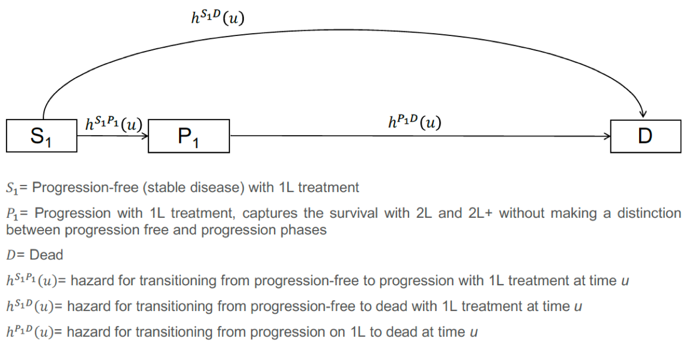
Example CTSTM in oncology (the IVI-NSCLC model)

Slide 64
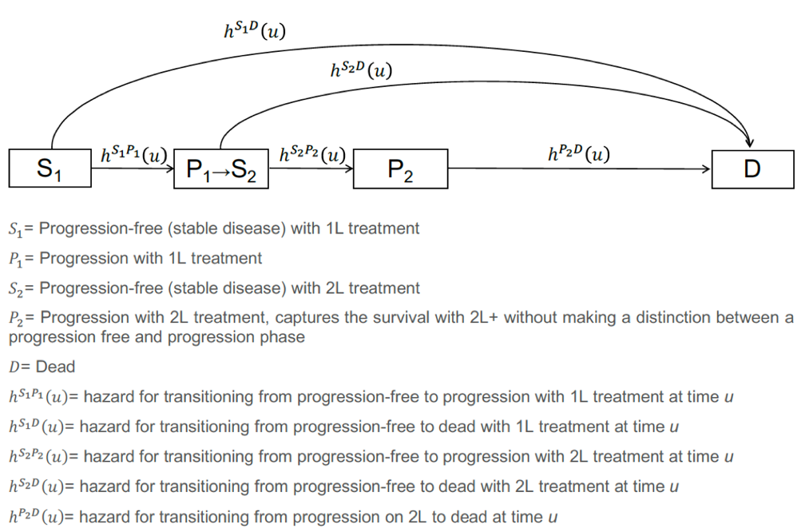
Expanding the standard 3-state oncology model to 4-states

Slide 65
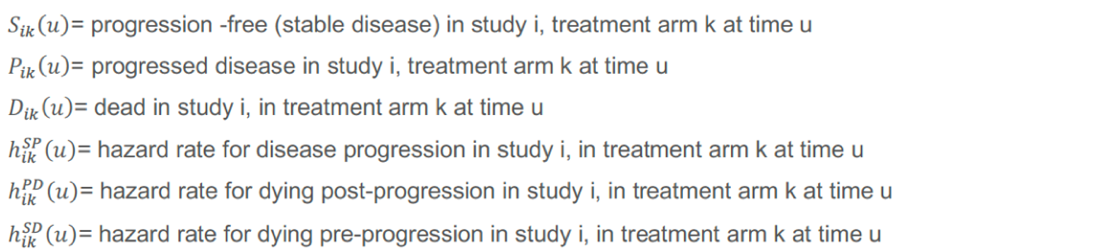
Parameterization using multi-state network meta-analysis conducted separately by line (1L, 2L)

Slide 66
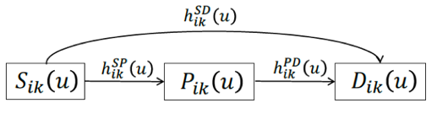
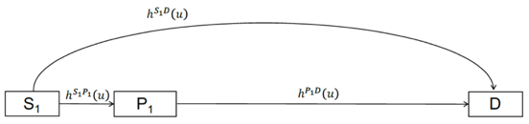
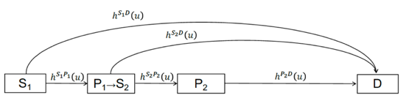
Integration of statistical and economic models
Evidence synthesis models
Simulation models

Slide 67
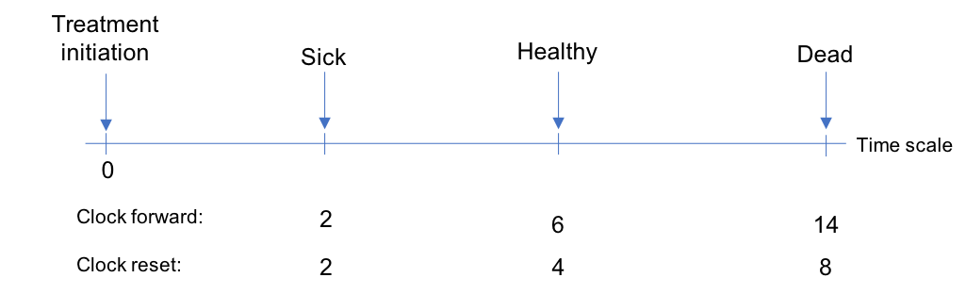
Time scales for multi-state models
Markov (i.e., “clock-forward”) implies that the hazard function is based on time since initiating 1L treatment
Semi-Markov (i.e., “clock-reset”) implies that the hazard function is based on time since entering each state
NMA is a “clock-forward” model
But time resets when entering S₂ in the 4–state model

Slide 68
Two methods for simulating multi-state models
Cohort simulation (Aalen-Johansen estimator)
Matrix version of the Kaplan-Meier estimator that can compute state occupancy probabilities
Only applicable to clock-forward models
Individual-level simulation
Simulate trajectories through multi-state model with random number generation for a large number of patients
Compute expected values by averaging over simulating patients
Applicable to both clock-forward and clock-reset models

Slide 69
Simulating a simplified 3-state NSCLC model with hesim using an individual-level simulation

Slide 70
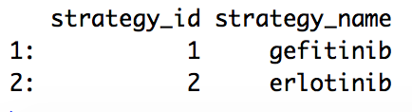
Treatment strategies
For simplicity, we will compare 2 treatment strategies
strategies <- data.table(strategy_id = 1:2,
strategy_name = c(“gefitinib”, “erlotinib”)
print(strategies)

Slide 71
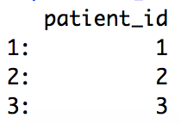
Target population
Economic evaluations are conducted for a target population of interest
Here we rely completely on summary-level RCT data so patients are identical (i.e., no covariates), but we will simulate 1,000 of them so that expected values are stable
patients <- data.table(patient_id = 1:1000)
patients[1:3]

Slide 72
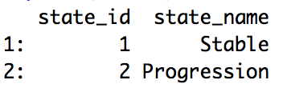
Model structure (health states)
The simplified NSCLC model has 3 health states, 2 of which are non-death states
states <- data.table(state_id = 1:2,
state_name = c(“Stable”, “Progression”)
print(states)

Slide 73
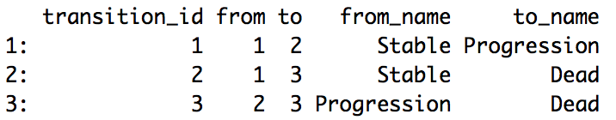
Model structure (health state transitions)
The model has 3 transitions, which are summarized with a transition table
tmat <- rbind(c(NA, 1, 2),
c(NA, NA, 3),
c(NA, NA, NA))
colnames(tmat) <- rownames(tmat) <- c(“Stable”, “Progression”, "Dead")
transitions <- create_trans_dt(tmat)
print(transitions)

Slide 74
hesim data
Information on the treatment strategies, target population, and model structure can be combined into a hesim_data object, which will later be used to create input data for the simulation
hesim_dat <- hesim_data(patients = patients,
strategies = strategies,
states = states,
transitions = transitions)

Slide 75
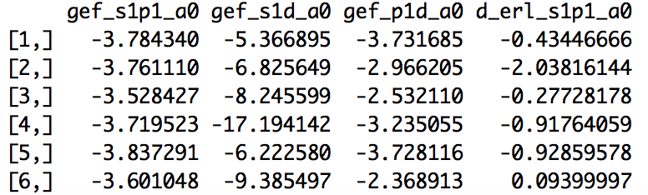
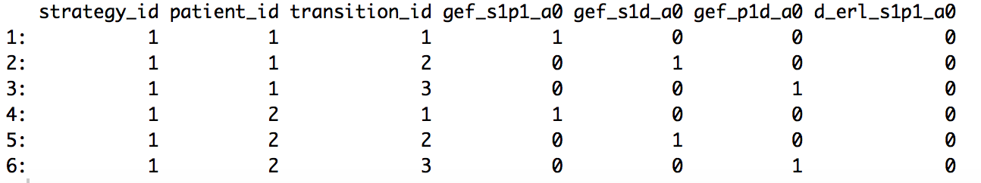
Constructing a model for health state transitions
The transition model consists of parameters from the multi-state (Weibull) NMA and input data used for prediction
transmod <- create_IndivCtstmTrans(object = params_mstate_nma_wei,
input_data = transmod_data,
trans_mat = tmat,
clock = "forward")
Parameters
Input data
Note: The Weibull distribution used for the NMA is a reparameterization of the standard Weibull distribution that depends on 2 parameters, a₀ and a₁, which are functions of the standard shape and scale parameters

Slide 76
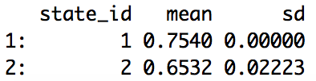
Constructing models for costs and utilities
The easiest way to model utilities and costs is from a stateval_tbl
utility_tbl <- stateval_tbl(data.table(state_id = 1:2,
mean = c(0.7540, 0.6532),
sd = c(0, 0.02223000)),
dist = "norm",
hesim_data = hesim_dat)
print(utility_tbl)
Which are, in turn, used to construct a “state values” model
utilitymod <- create_StateVals(utility_tbl, n = 1000)

Slide 77
Creating an economic model by adding costs and utility models
The CTSTM is constructed by combing the transition, utility, and cost models
econmod <- IndivCtstm$new(trans_model = transmod,
utility_model = utilitymod,
cost_models = costmods)

Slide 78
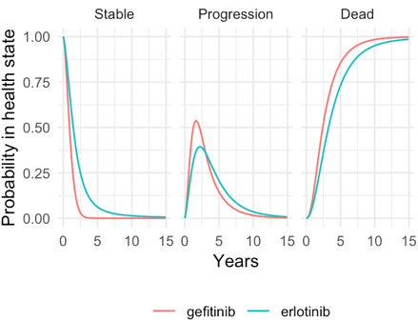
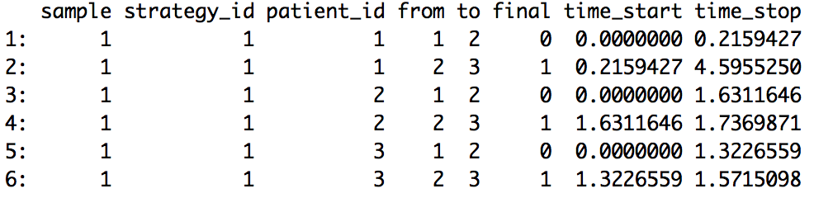
Simulating health state transitions
In the individual-level CTSTM, unique trajectories through the multi-state model are simulated for each patient, treatment strategy, and PSA sample
econmod$sim_disease()
econmod$sim_stateprobs(t = seq(0, 20 , 1/26))
Disease progression
State probabilities

Slide 79
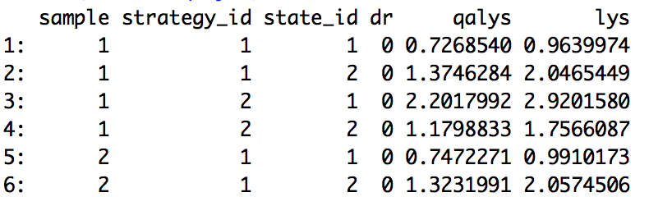
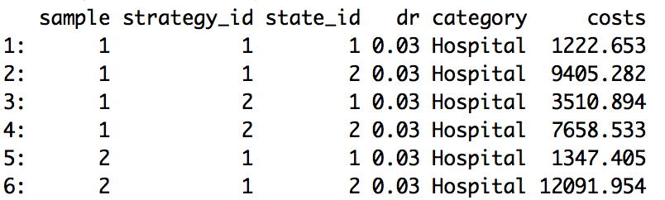
Simulating QALYs and costs
By default, mean QALYs and costs are simulated by treatment strategy, patient, health state, and PSA sample
econmod$sim_qalys(dr = c(0, .03))
econmod$sim_costs(dr = .03)
QALYs
Costs

Slide 80
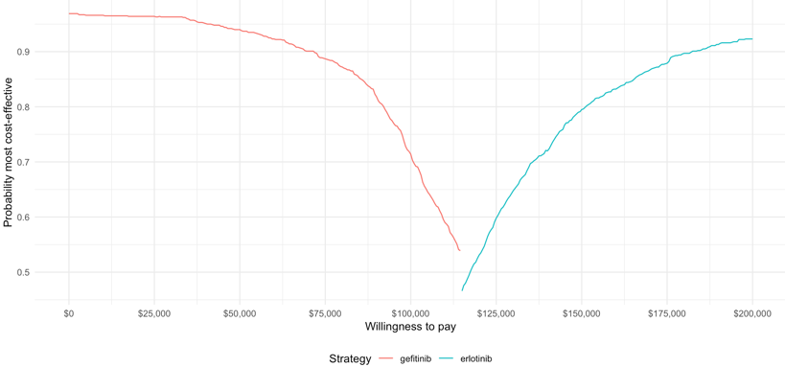
Cost-effectiveness analysis
Summaries of costs and QALYs (i.e., estimates by treatment strategy and PSA sample) are used to perform a (potentially “individualized”) CEA
ce_sim <- econmod$summarize()
icea_out <- icea(ce_sim, dr_qalys = .03, dr_costs = .03)
icea_pw_out <- icea_pw(ce_sim, comparator = 1, dr_qalys = .03, dr_costs = .03)
Cost-effectiveness acceptability frontier

